Slide 1
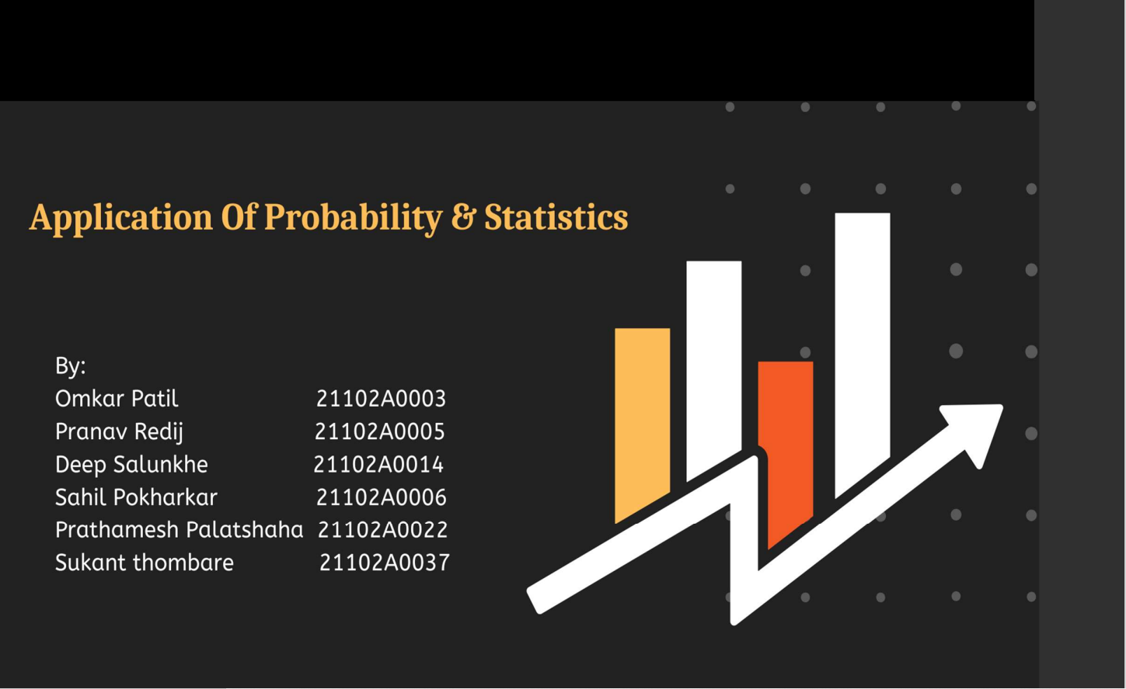

Slide 2

SAY HELLO TO PROBABILITY

Slide 3

HISTORY OF PROBABILITY
The mathematical methods of probability arose in the investigations first of Gerolamo Cardano in the 1560s (not published until 100 years later), and then in the correspondence Pierre de Fermat and Blaise Pascal (1654) on such questions as the fair division of the stake in an interrupted game of chance. Christiaan Huygens (1657) gave a comprehensive treatment of the subject.
From Games, Gods and Gambling by F. N. David :
In ancient times there were games played using astragali, or Talus bone. Pottery of ancient Greece was evidence to show that there was a circle drawn on the floor and the astragali were tossed into this circle, much like playing marbles. In Egypt, excavators of tombs found a game they called "Hounds and Jackals", which closely resembles the modern game " Snakes and Ladders ". It seems that this is the early stages of the creation of dice.
The first dice game mentioned in literature of the Christian era was called Hazard. Played with 2 or 3 dice. Thought to have been brought to Europe by the knights returning from the Crusades.

Slide 4
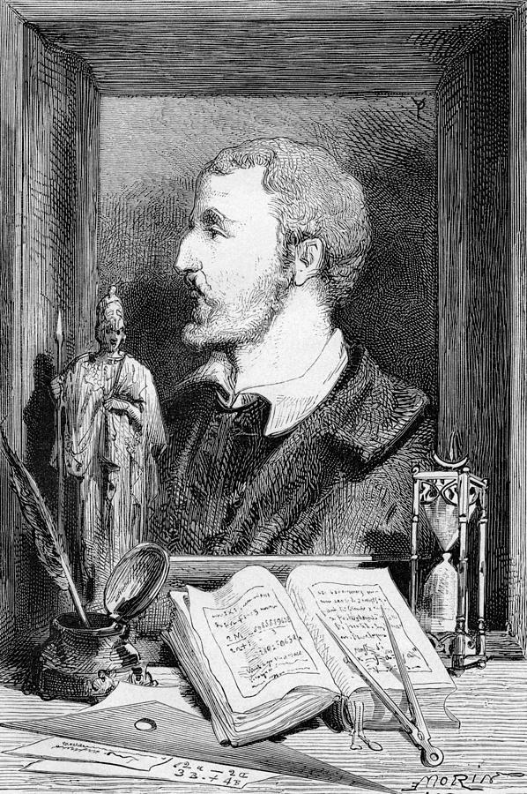
Earliest known use: Arab mathematicians[8th-13th c.] largely related to crypotographic communications AI-Kindi (9th c.): first known to make statistical inference
Later further developed by Europeans to study games of chance 16th c :Italian polymath Gerolamo Cardano 17th c :Frenchmen Pierre de Fermat and Blaise Pascal
Largely combinational up to this point in history eg.working with integers of count data
Modern probability Theory :- Mostly devised in 20th c.
(e.g.Soviet Kolmogorov,Austrian von Mises) Allows us to work with continuous real (e.g.float)values
Gerolamo Cardano

Slide 5


BEFORE YOU GO.......
WHAT IS PROBABILITY ?
Probability is the branch of mathematics concerning numerical descriptions of how likely an event is to occur, or how likely it is that a proposition is true. The probability of an event is a number between 0 and 1.
The higher the probability of an event, the more likely it is that the event will occur.
A simple example is the tossing of a fair (unbiased) coin. Since the coin is fair, the two outcomes ("heads" and "tails") are both equally probable; the probability of "heads" equals the probability of "tails"; and since no other outcomes are possible, the probability of either "heads" or "tails" is 1/2 (which could also be written as 0.5 or 50%).

Slide 6


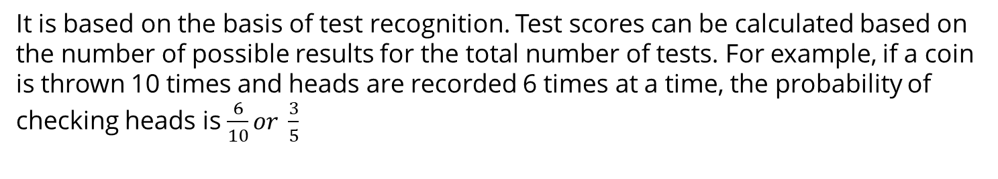
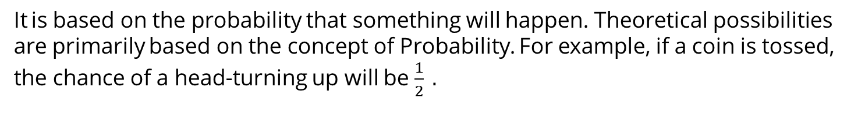


It is based on the probability that something will happen. Theoretical possibilities are primarily based on the concept of Probability. For example, if a coin is tossed, the chance of a head-turning up will be $\frac{1}{2} .$
TYPES OF PROBABILITY
THEROTICAL PROBABILITY
2
EXPERIMENTAL PROBABILITY
It is based on the basis of test recognition. Test scores can be calculated based on the number of possible results for the total number of tests. For example, if a coin is thrown 10 times and heads are recorded 6 times at a time, the probability of checking heads is $\frac{6}{10}or \frac{3}{5}$

Slide 7
3
AXIOMATIC PROBABILITY
The axiomatic approach to probability was introduced by Russian mathematician Andrey Nikolaevich Kolmogorov, who lived from 1903 to 1987. He said that there exist three axioms that can be applied to determine the probability of any event (E).
Kolmogorov's Three Axioms are as follows:-
The probability of an event A is always greater or equal to zero but can never be less than zero.
If S is a sample space, then the probability of occurrence of sample space is always 1. That is, if the experiment is performed, then it is sure to get one of the sample spaces.
For mutually exclusive events, the probability of either of the events happening is the sum of the probability of both the events happening.

Slide 8

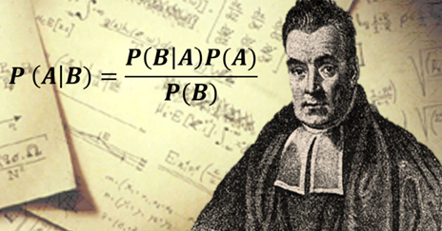
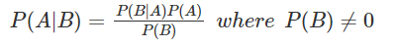
BAYES’S THEOREM
Bayes' Theorem, named after 18th-century British mathematician Thomas Bayes, is a mathematical formula for determining conditional probability. Conditional probability is the likelihood of an outcome occurring, based on a previous outcome having occurred in similar circumstances. Bayes' theorem provides a way to revise existing predictions or theories (update probabilities) given new or additional evidence.
In finance, Bayes' Theorem can be used to rate the risk. of lending money to potential borrowers. The theorem is also called Bayes' Rule or Bayes' Law and is the foundation of the field of Bayesian statistics.

Slide 9

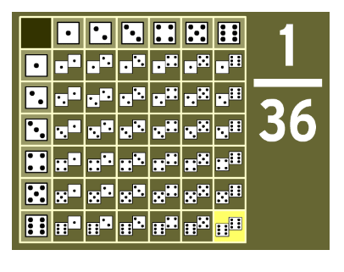
APPLICATION 1:- GAME THEORY
When two dices are rolled simultaneously, the outcomes will be as given below
GAME THEORY :-
It is the study of mathematical representation of strategic relations among analytical outcomes. It has applications in social science, logic, system science, and computer science. In 1944, John Von Neumann published a paper, "Theory of Games and Economic Behaviour". He proved Brouwer’s fixed point theorem on continuous mapping into compact convex sets, the standard game theory method.

Slide 10

APPLICATION OF PORTABILITY IN GAME THEORY
1.Economics and business: Economists use game theory as a tool to analyze economic competition and phenomena such as bargaining, voting theory, auction, mechanism design. Executives, investors, and managers in the business world use the game theory strategy for investments, launching of new products, or entering a new business. Game theory models force each player to consider the action made by their competitor and plan the next strategy.
2. In politics: Diplomats and politicians use game theory to analyze any situation of conflict between individuals, companies, states, and political parties. It is also used in war strategies, political voting, and political affairs.
3. In philosophy: Philosophers use game theory in various aspects of philosophy.
4. In biology: It is applied to the analysis of the abnormal natural phenomenon in biology.

Slide 11

APPLICATION 2:-
STOCK MARKET TRADING
Is it possible to use Probability in Trading?
A probability distribution is a statistical function that describes all the possible values and likelihoods that a random variable can take within a given range.
Let’s break down this definition with an example. You want to record the daily returns of Amazon stock for 100 days. Here, the random variable is the daily returns. The range varies from 0 to 100 days.
You record the returns in a tabular format. Through the distribution, you can analyse the average returns of the stock and how dispersed the returns are from the average return. It is useful when you want to know all the possible outcomes and which outcome is most likely to happen.
Statistically, we denote the random variable like x, and the likelihood that this random variable takes a specific value of x is denoted by p(x).
You need to know the type of random variable so that you can analyse your data set better. The type of a random variable determines the probability distribution.

Slide 12
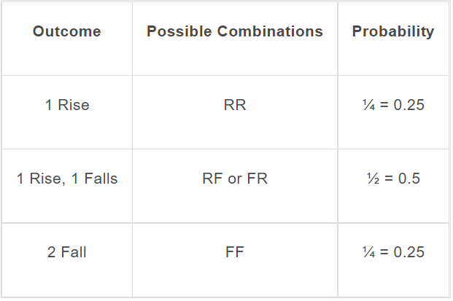
There are two types of random variables:
Discrete random variables
Continuous random variable
Discrete probability distribution for discrete random variables
When you toss a coin or when you take a trading decision to buy, sell or hold a stock, your answer is a discrete value. These two are examples of a discrete distribution because there are no in-between values.
Let’s say you want to calculate the probability of the market rising or falling for two consecutive days, assuming an equal probability of the market rising or falling each day.
We will ignore the possibility of no change for the sake
of simplicity.
You will get the following set of outcomes.
Here, “R” denotes Rising and “F” denotes Falling.

Slide 13
We have four possible outcomes. The market rises for 2 consecutive days, which is one out of the four possible outcomes. Therefore, the probability of this event is ¼ or 0.25. Similarly, we can calculate the probability of the market falling for two consecutive days.
The next possible set outcome is that the market falls on the first day and rises the next day or vice versa. This creates two possible outcomes. The probability of this event is 2/4 or 0.5.
Therefore, for this event, the discrete values create a discrete probability distribution.
Probability distribution for continuous random variables
When there is a change in the returns of a stock within a particular range, there are an infinite number of other valid values between two values. This is because accurate measurements can go up to any decimal value. The returns of a stock, for example, is a continuous random variable.
Normal distribution using Python
Let’s take amazon stock for example. For our dataset, we will use the following code in python.
This will give the time-series data set for Amazon. We calculate the daily percentage change for the adjusted close price of the stock and store it in the data set under daily_percentage_change.
We’ll base our analysis on the daily percentage change in the price for this stock.
import yfinance as yf
amzn = yf.download("AMZN", "2010-01-01", "2021-01-01") amzn['daily_percent_change'] = amzn['Adj Close'].pct_change()
amzn

Slide 14
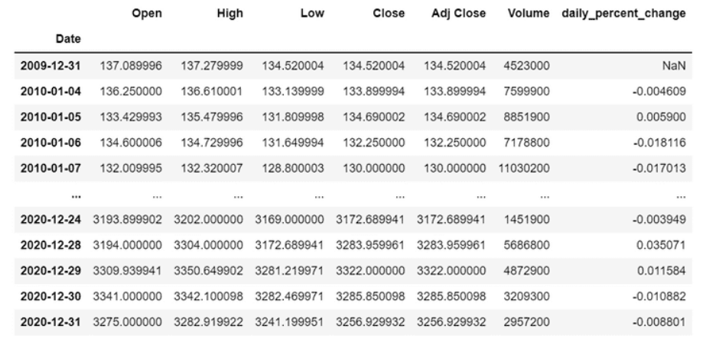
Before plotting these values, we can calculate the mean percentage change and the standard deviation of the percentage change. Calculating these statistical measures helps us understand and analyse our data set better.
mean = amzn['daily_percent_change'].mean()
standard_deviation = amzn['daily_percent_change'].std()
print('Mean = ', mean)
print('Standard Deviation = ', standard_deviation)

Slide 15
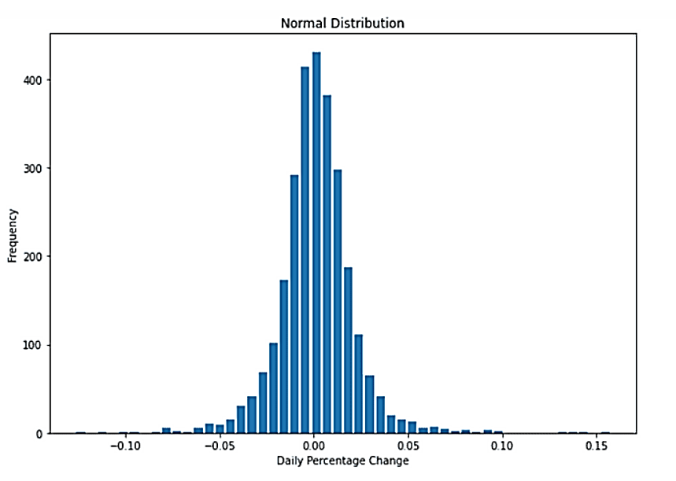
We get the following output:
Mean = 0.00135
Standard Deviation = 0.01999
The mean percentage change for the amazon stock is approximately 0.00135 or 0.135% and the standard deviation for the stock is approximately 0.01999 or 1.999%. The standard deviation tells us how far the value deviates from the mean. So, the major part of our data lies between mean ± standard deviation, i.e., 0.00135 ± 0.01999
Now, let’s plot our data.
import matplotlib.pyplot as plt
%matplotlib inline plt.figure(figsize=(10,7))
amzn_plt = plt.hist(amzn['daily_percent_change'], bins = 50, histtype = 'bar', rwidth = 0.8) plt.title('Normal Distribution’)
plt.ylabel('Frequency’)
plt.xlabel('Daily Percentage Change’)
plt.show()
We get the following output:

Slide 16

As you can observe, our distribution looks like a bell-shaped curve. This type of distribution is known as a normal distribution. It is a symmetric distribution with two parameters: mean and standard deviation.
The majority of data lies in the middle and the mean divides the data in half. The mean can be interpreted as the expected percentage change for the stock and the standard deviation as the risk associated with investing in this stock.
As the returns are normally distributed for this data set, we can calculate the minimum and maximum values or the range for the returns. This makes the improbable a bit more probable.
Conclusion:-
Probability is a mathematical concept that can be used and applied in the domain of trading. All smart traders and legendary investors like Warren Buffet use probability to create intelligent and well-designed trading strategies and refine decision-making.

Slide 17
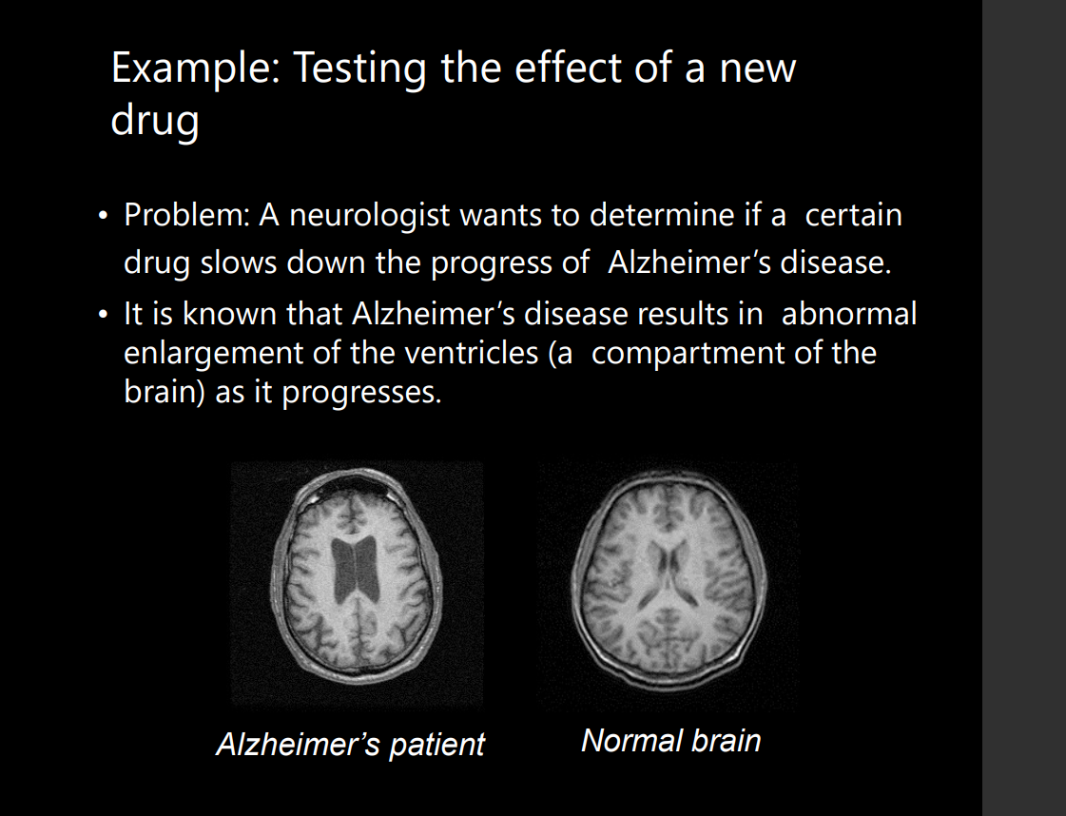


Slide 18
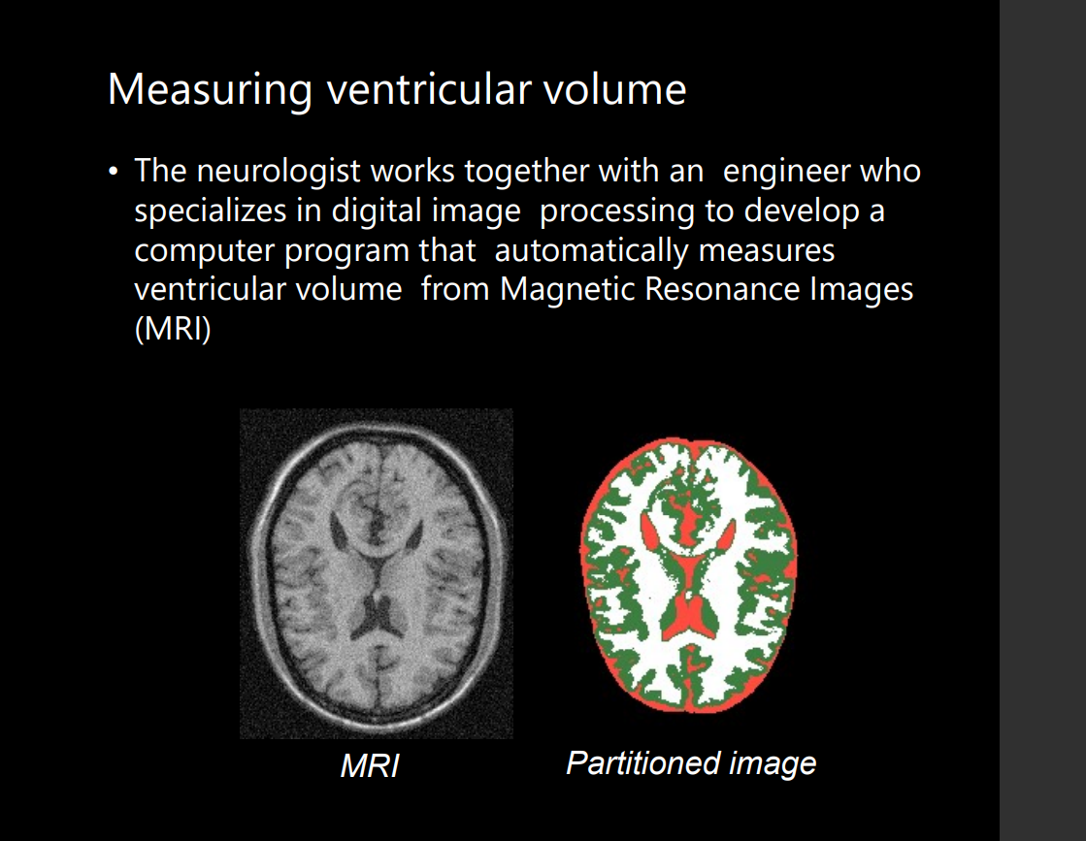

Slide 19


